Slide 1

ApproxIoT Approximate Analytics for Edge Computing https://ApproxIoT.github.io/ApproxIoT/
Zhenyu Wen, Do Le Quoc,
Pramod Bhatotia, Ruichuan Chen, Myungjin Lee

Slide 2

Modern online services
Stream
aggregator
Stream analytics system
Useful
Information
Processing streaming data from different sources

Slide 3


Modern online services
Tension
Low latency
Efficient resource
utilization
Approximate computing

Slide 4
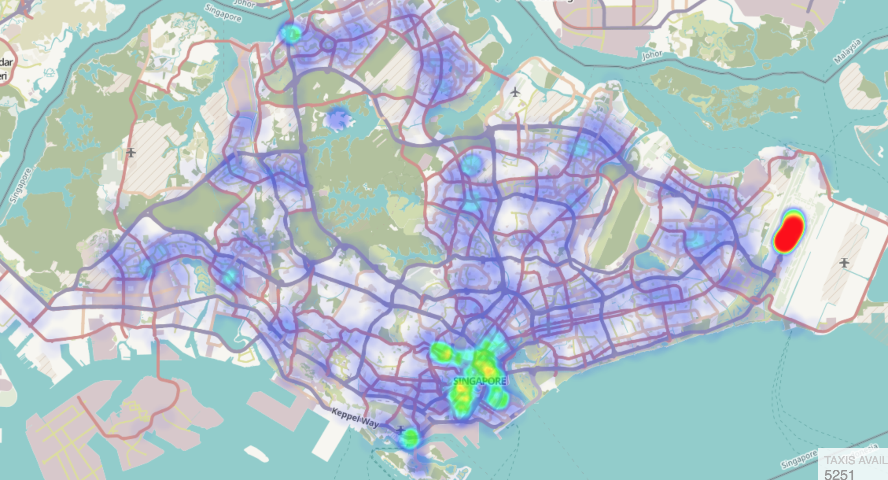
Approximate computing
Many applications: Approximate output is good enough!
The proportion of data is useful for this application
Live taxi heatmap

Slide 5
Approximate computing
Idea: To achieve low latency, compute over a sub-set of data items instead of the entire data-set
Approximate computing
(sampling)
Analyze
Approximate output ± error bound

Slide 6
State-of-the-art system
StreamApprox [Middleware’17]
S₁
Stream
aggregator
Data stream
S₂
StreamApprox
Approximate output ± error bound
…
S_{n}
Cloud datacenter
Limitations:
It wastes bandwidth
It utilizes only cloud datacenter resources

Slide 7




Edge computing
Allows data to be processed at the edge
node before it’s sent to the cloud
Source of data
Edge node
Local processing
Cloud
Gateway
Opportunities:
Providing more computing resources
Saving bandwidth

Slide 8

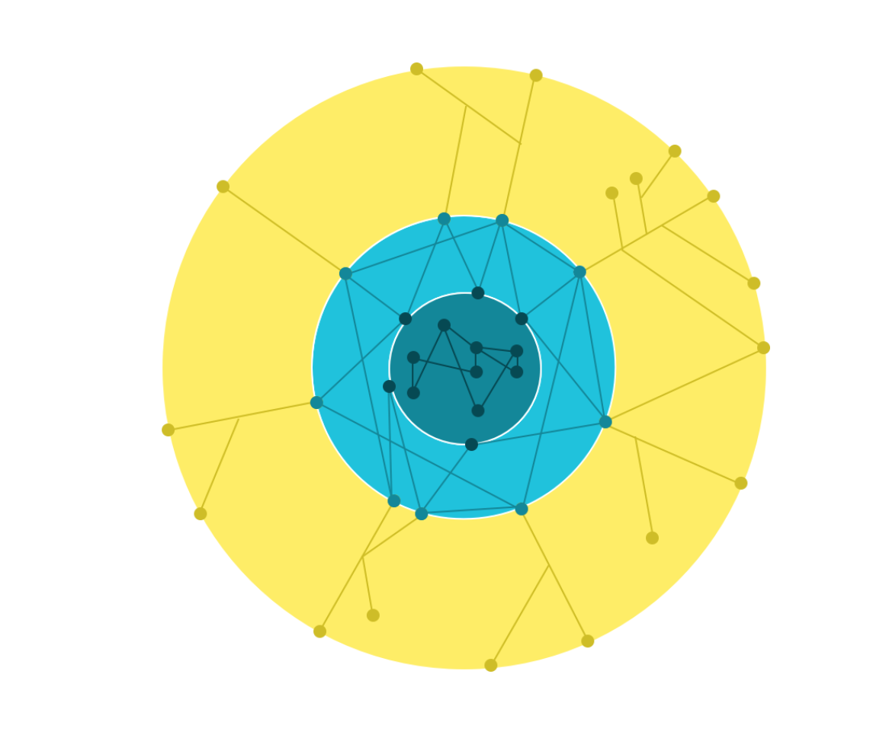


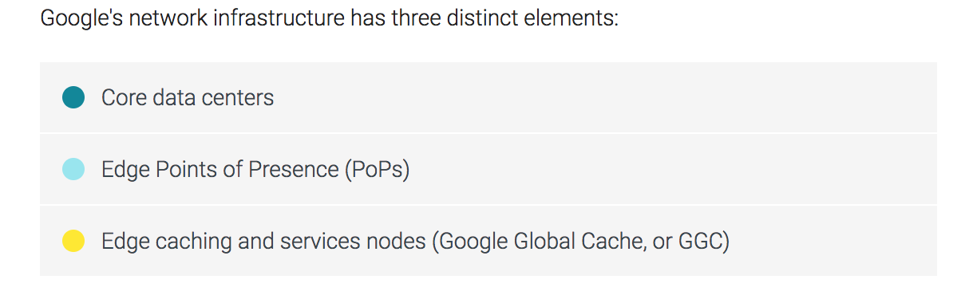

Edge infrastructure
Azure IoT edge
Watson IoT
AWS IoT
Source: https://peering.google.com/#/infrastructure

Slide 9
Problem statement
To build a stream analytics system
By utilizing the cloud and edge computing resources
By leveraging approximate computing
Design goals
Efficiency: Efficient utilization of computing resources
Adaptability: Adaptive execution based on the available resources
Transparency: No code change required and resource management

Slide 10
Outline
Motivation
Design
Implementation
Evaluation

Slide 11

ApproxIoT: Overview
Regional edge
Query
Continental node
Edge nodes
Cloud
S₁
…
S_{i}
Central node
Approximate output
± error bound
…
S_{m}
…
S_{n}
ApproxIoT
ApproxIoT employs sampling in the distributed environment of
edge + cloud

Slide 12
Naïve algorithm
Simple random sampling (SRS)
SRS
Query
Approximate output
± error bound
Overlooked
Sampled unfairly
Low accuracy

Slide 13
Background: Stratified sampling
Stratified sampling
Advantage: The sub-streams are sampled fairly
Disadvantage: Requires the knowledge of each sub-stream size

Slide 14
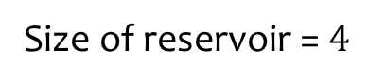
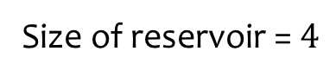
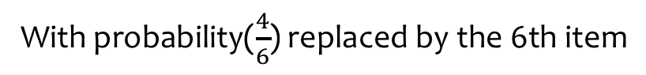
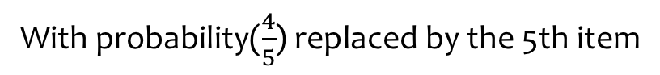
Background: Reservoir sampling
With probability($\frac{4}{6}$) replaced by the 6th item
The 5th item
With probability($\frac{4}{5}$) replaced by the 5th item
The 6th item
Reservoir sampling
Reservoir sampling
Reservoir sampling
Reservoir sampling
Reservoir sampling
Reservoir sampling
Reservoir sampling
Size of reservoir = $4$
Size of reservoir = $4$
Size of reservoir = $4$
Size of reservoir = $4$
Size of reservoir = $4$
Size of reservoir = $4$
Size of reservoir = $4$
Advantage:
No pre-knowledge required of sub-stream size
Disadvantages:
The sub-streams are sampled unfairly
Difficult to run on multiple nodes

Slide 15
ApproxIoT sampling algorithm
Weighted hierarchical sampling (WHS)
Combining stratified and reservoir sampling
With initial weight 1
Reservoir size N=4
Weight: C/N, if C>N
1, if C <=N
C=6
WHS
W=1
W=6/4
W=1
W=1
W=1
W=1
Easy to parallelize, requires no synchronization between sub-streams

Slide 16
WHS on edge nodes
Regional edge
Continental node
Edge nodes
Cloud
Regional
edge
W=1
Central node
WHS
W=6/2=3
W=1
W=4/2=2
W=1
W=1
Carried weight
Current weight
Continental
node
W=4
WHS
W=4*5/2=10
W=1
W=1*3/2=3/2
W=3
W=3
Easy to parallelize, requires no synchronization between computing nodes
Reservoir size equals 2

Slide 17
ApproxIoT in the cloud
Regional edge
Continental node
The weights are carried
Edge nodes
WHS
Cloud
Query (sum)
W=4/3
W=4/3*6/1 =8
W=1
Central node
W=1*4/1=4
W=1
W=1*2/1=2
Approximate output:
8*
+4*
+2*
± error bound
Reservoir size equals 1

Slide 18
Outline
Motivation
Design
Implementation
Evaluation

Slide 19


Implementation
S₁
See the paper for more details
S₂
Kafka
cluster
…
S_{n}
Data stream
Edge
nodes
Stream
pub/sub
Cloud
datacenter
Sampled
data stream
Sampled
data stream
Kafka Streams

Slide 20
Experimental setup
Evaluation questions
Accuracy vs. sample size
Throughput vs. sample size
Testbed: 25 nodes
15 nodes for ApproxIoT deployment
10 nodes for Kafka cluster
Datasets:
Synthetic: Poisson and Gaussian distribution
Real: Brasvo pollution and New York Taxi Ride
See the paper for more results!

Slide 21
Accuracy vs. sample size
The average is 0.035%
Lower
the better
ApproxIoT: ~2600X higher accuracy over SRS

Slide 22
Throughput vs. sample size
Higher
the better
ApproxIoT has low overhead compared to the native execution
ApproxIoT has similar throughput as SRS

Slide 23
Conclusion
ApproxIoT: Approximate analytics for edge computing
Efficiency
Efficient computing and bandwidth resource utilization
Adaptability
Adaptive execution based on the available resources
Transparency
Requires no code changes and resource management
Thank you!
More details on the project website:
https://ApproxIoT.github.io/ApproxIoT/

